Slide 1
Can you spot the hidden message in these famous logos?
Digital Media Art: Mr. Uhl
Adapted From: Mrs. Baxter, Conroe HS 2012

Slide 3
Do you see the arrow between the second "E" and "x"??

Slide 4
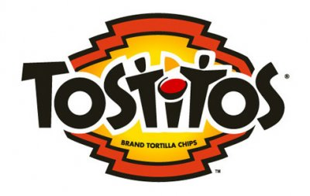

Slide 5
The 2nd and 3rd "t's" are two people sharing a tortilla over a bowl of salsa.

Slide 6
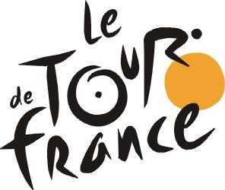

Slide 7
Probably the world's most famous bike race. The "R"? in "Tour"? is a cyclist yellow circle front wheel of bicycle.

Slide 9
Arrow probably means Amazon has everything from A to Z?

Slide 10
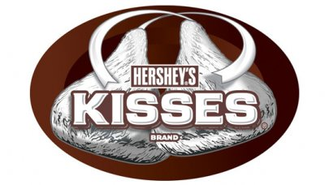

Slide 11
There is a sideways chocolate kiss between "K" and "I."

Slide 12
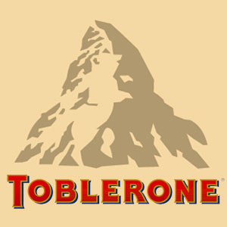

Slide 13
There is a bear if you look closely at image of Matterhorn . Toblerone chocolate bars originated in Berne, Switzerland whose symbol is the bear.

Slide 14
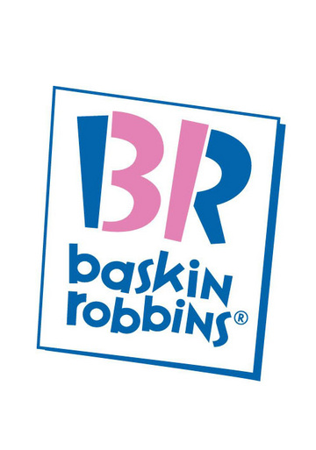

Slide 15
See "31" embedded in the "B R?" Thirty one-wonderful flavors!

Slide 16
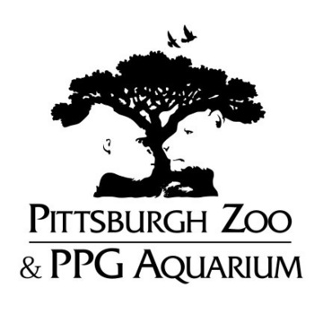

Slide 17
See the gorilla and lioness?

Slide 18
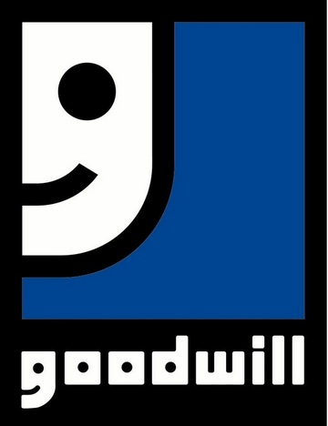

Slide 19
Smiley face is also a "g" like in "goodwill."

Slide 20
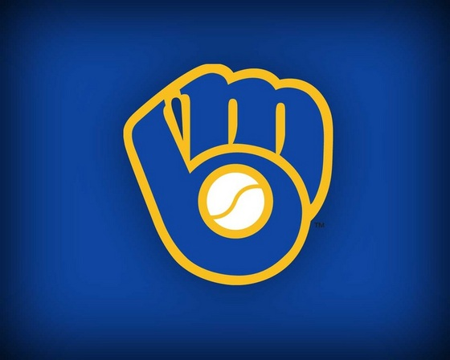

Slide 21
Used to be the emblem for the Milwaukee Brewers. Baseball glove forms an "M" and a "B." Logo was designed by a college art student.

