Slide 1
Examples From Photoshop
The following are examples of Surrealism that have been done using Photoshop. However, the concept is the exact same for your drawing.
Collect images that you find interesting or that you feel might come together to make an interesting composition.
Consider a “theme”, landscape, or concept when you begin looking for images. How can they come together to make an entire composition. Remember, it doesn’t have to make sense, it just needs to be unified. This is not a “COLLAGE”.

Slide 3
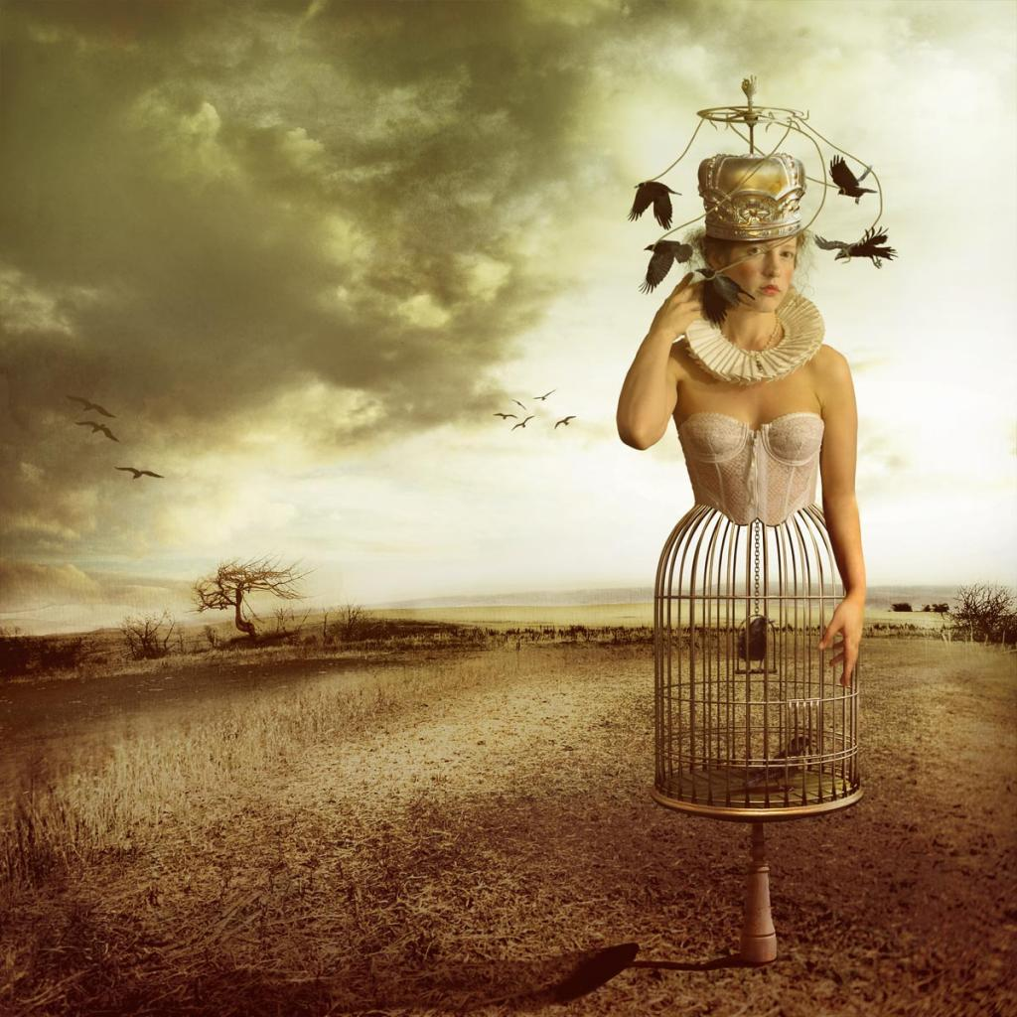

Slide 4
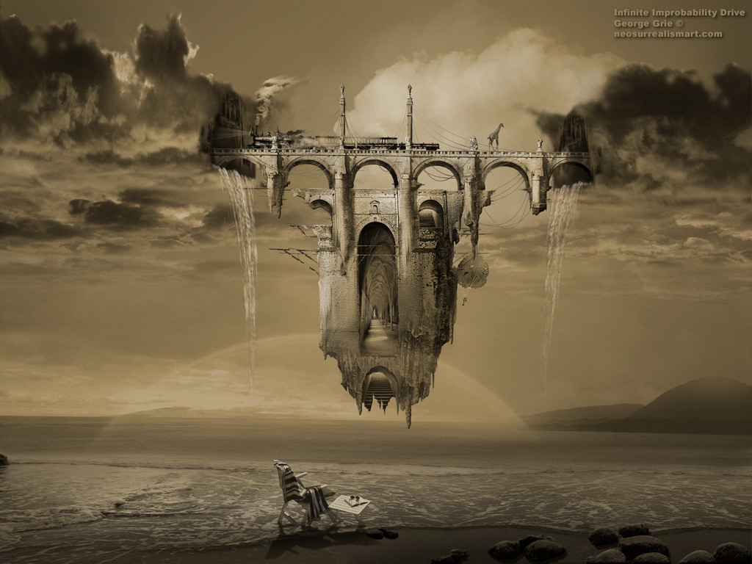

Slide 5
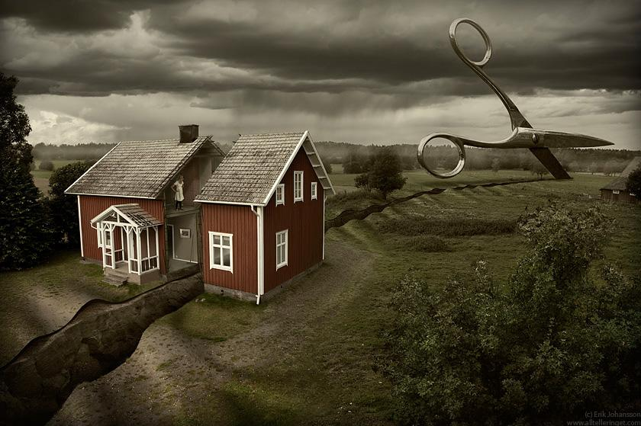

Slide 6
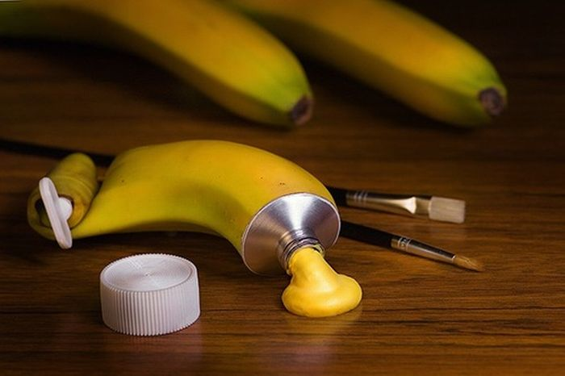

Slide 7
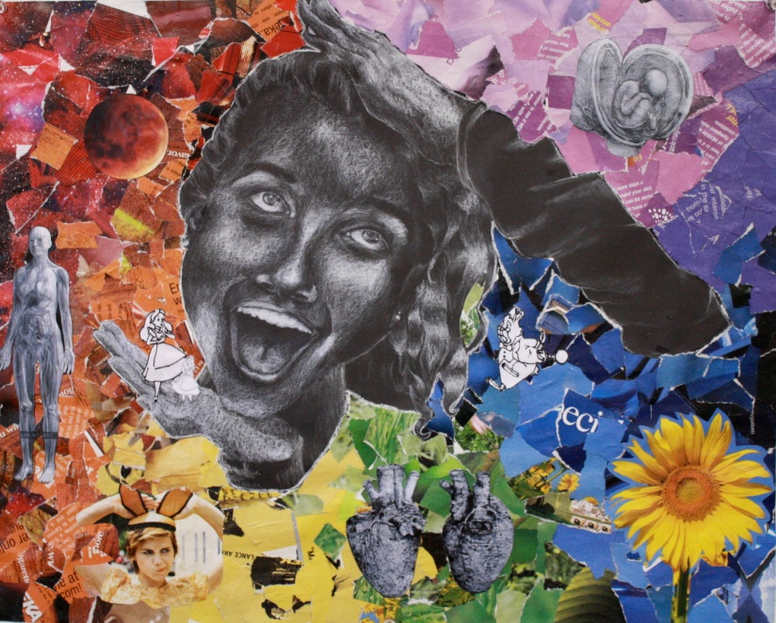
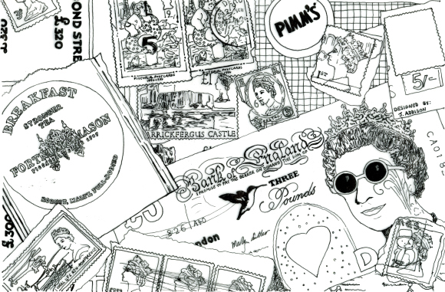
Examples of Collages (this is what NOT to do)
A collage is a form of art. It can be interesting and make good art. However, the point of Surrealism is that the items in the work are connected in a realistic way with a message in mind– it’s a new world or scene. It is not like “scrapbooking” where items are cut, pasted, and simply overlap.

